Slide 1
Reflectometry

Slide 2
Instruments
New OFFSPEC IDF is now in use in Mantid
‘vertical gap’ now used to define slits across all instruments in Reflectometry
Updated due to issues running ‘CalculateResolution’ algorithm.

Slide 3
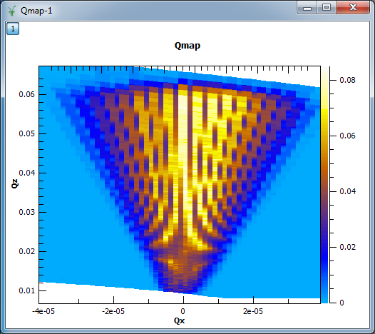
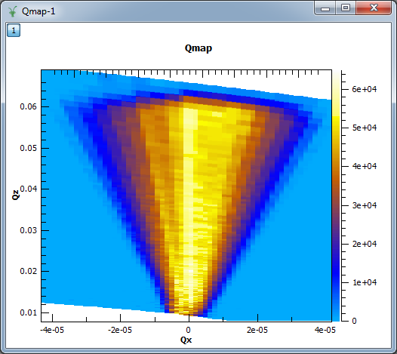
ConvertToReflectometryQ
Theta vs Lam plot was normalised by bin width
To regain original intensity we must undo the normalisation
The problem arose when calculating the QxQz map from this normalisation

Slide 4
ReflectometryReductionOne
Transmission corrections options are now applicable with both PointDetectorAnalysis and MultiDetectorAnalysis modes
The Transmission corrections will be applied now if at least one Transmission Workspace has been provided.
Default value for WavelengthStep property has changed from 0.05 to 0.02

Slide 5
ISIS Reflectometry (Polref) Interface
ICAT search no longer crashes if incorrect credentials are used.
Plotting a row that contained no run number entry will no longer cause a crash

Slide 6
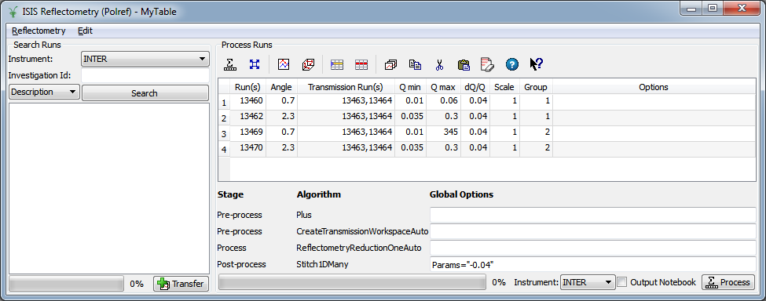
ISIS Reflectometry (Polref) Interface
Local and Global Options
No Auto-populate for Scale column
Generic Data Processor should be useful for other technique areas

Slide 7
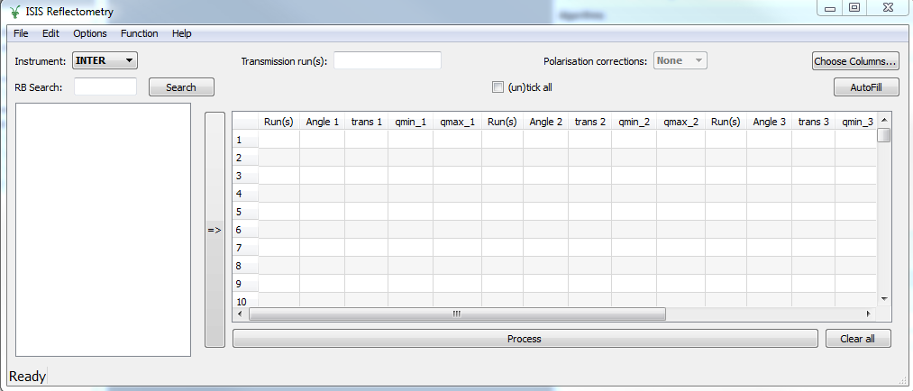
ISIS Reflectometry Interface
Calculation of minimum and maximum Momentum Transfer has been fixed

Slide 8
Loading and Saving TBL files
SaveReflTBL SaveTBL
LoadReflTBL LoadTBL
TBL format will now be used across different technique areas
Old TBL files will still work with algorithms
SaveTBL will now re-format old TBL files
New Format contains first line of column headings and subsequent lines contain values for columns.
Example:
Runs, Theta, Transmission, Group, Options
13460, 1.5, 13463,1, ,
13461, 2.5, 13463,2, ,

